Slide 1


Software Bug Prediction Using Supervised Machine Learning Algorithms
Presented by: Nirmani Wettasinghe
Index No: s16176
Reg No:2021s19028
Course: MS 4016
01

Slide 2



The Challenge: Software Bugs in Development
Software bugs are a major challenge in today’s development.
Identifying bugs early in the Software Development Life Cycle (SDLC) can greatly lower detection and fixing costs.
This practice is called defect prediction.
Quality Impact
Cost Reduction
Timeline Benefits
Early detection improves software reliability and consistency
Prevents 10% average operational cost increase
Reduces development delays and delivery time
02

Slide 3

Defect Life Cycle
New
Deferred
New: Bug reported for the first time.
Assigned: Given to a developer to fix.
Open: Developer confirms it’s a valid bug.
Fixed: Bug is corrected.
Retest: Tester checks the fix.
Reopen: Bug reappears after fixing.
Rejected: Not a valid bug.
Deferred: Fix postponed to next release.
Duplicate: Same bug reported again.
Closed: Bug verified and closed.
Reopened
Assigned
Rejected
Open
Duplicate
Fixed
Retest
Close
03

Slide 4

Research Gaps Identified
Research Gap | How It Was Addressed in This Study
Models not tested on many datasets | Used multiple GitHub datasets for better results
No cross-validation used | Applied 10-Fold Cross Validation for accuracy
Data was imbalanced | Used SMOTE to balance bug and non-bug data
Few software metrics considered | Added more software metrics for training
Weak models used | Used strong ML algorithms (Logistic Regression, Naïve Bayes, Decision Tree, Random Forest)
Accuracy not consistent | Combined cross-validation and ensemble methods for stable accuracy (up to 97%)
04

Slide 5


Machine Learning Algorithms for Bug Prediction
Machine Learning (ML) helps computers learn from past data and make predictions.
In software projects, ML can predict where bugs may occur before testing.
This study uses Supervised ML algorithms, which learn from labeled data (bug / no bug).
Compare different ML algorithms to see which works best.
Identify the model with the highest accuracy for bug prediction.
Algorithms Used: Logistic Regression,Decision Tree & Random Forest,Naïve Bayes
05

Slide 6
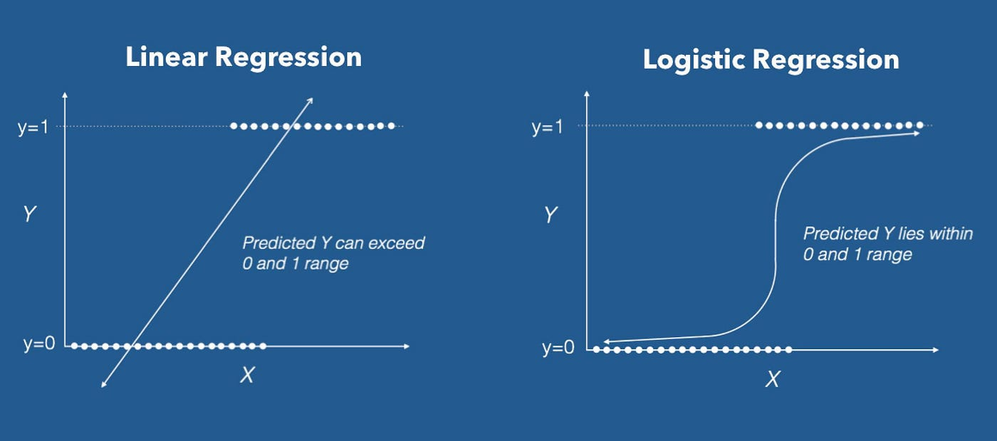
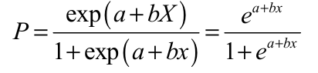
01.Logistic Regression
Borcelle
Used for predicting the likelihood of an event (e.g., bug occurrence) belonging to one of two classes — bug or no bug.
P(Y=1) → Probability of bug occurrence
a, b → Regression coefficients
X → Input variable(s)
Uses Chi-square statistic (instead of R²) to measure fit.
Model iteratively finds best-fit parameters for accurate predictions.
Finance Presentation
06

Slide 7


03. Random Forest
Ensemble of multiple decision trees
Reduces overfitting, improves accuracy
Classification → majority vote, Regression → mean prediction
Trees trained on random subsets of data & features
02. Decision Tree
Supervised learning for classification & regression
Splits data based on most important features
Uses Information Gain / Gini Index
Can handle categorical & continuous data
07

Slide 8
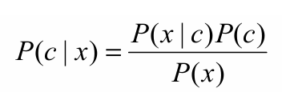

04. Naïve Bayes
Based on Bayesian Decision Theory – foundation for Decision Trees, Neural Networks, and EM Algorithm.
Applications: Statistical Theory and Pattern Recognition.
Assumption: Features are independent (no correlation).
P(c∣x): Posterior probability of class given predictor
P(c): Prior probability of class
P(x∣c): Likelihood of predictor given class
P(x): Prior probability of predictor
08

Slide 9
System Design and Methodology
This method follows a clear framework to develop a thorough bug prediction model. Each phase builds upon the last, starting with problem definition and culminating in validation. This creates a strong and adaptable solution that works across various software development life cycle models, including Waterfall, Agile, V-Shaped, and Spiral methodologies.
Problem Solving
Define problem and identify key factors
Data Preprocessing
Clean and prepare analytical dataset
Baseline Model
Create logistic regression model
Model
Validation
Test on confusion matrix, or ROC-AUC Curve.
Benchmarking
Validate with Random Forest classifier
K Fold Validation
Test using K-Fold cross validation
09

Slide 10


Selecting Data Sets
Tools & Source
Tools: Python (primary), SPSS (alternative)
Projects: 15 Java & Python projects from GitHub
Method: Matched known/fixed bugs with source code elements
Software Metrics
Dimensional Metrics
Number of Byte-code Instructions (NBI), Number of Classes (NOC), Number of Methods (NOM), Instructions per Method (IPM)
|
||
Complexity Metrics
Cyclomatic Complexity (CC), Weighted Methods per Class (WMC)
|||
Object-Oriented Metrics
measure quality, cohesion, and coupling:NOCH, DIT, LCOM, CBO, PPIV, APD
|V
Android Metrics
capture mobile-specific errors: BSMC, WKL, LOCL, GPS, XML, NTO
10

Slide 11

Data Pre-Processing
clean and prepare raw data for accurate model training and prediction.
🧩 Data Collection & Merging – Combine datasets from multiple projects (e.g., GitHub repositories).
🧹 Null Value Treatment – Handle missing values appropriately.
🚫 Outlier & Garbage Removal – Eliminate invalid or extreme values.
🔤 Text Processing –
Stop-word removal: “the,” “is,” “and” that don’t add meaning
Stemming and Lemmatization: , basic form, Change words to their root meaning (e.g., “better” → “good”),
Tokenization & POS tagging: splits text into words, and tells the type of each word (like noun or verb).
⚖️ Balancing Data – Convert imbalanced data to balanced using SMOTE (Synthetic Minority Over-sampling Technique).
A clean, analytical dataset with 182,962 rows and 113 columns, ready for model training.
11

Slide 12
The Base line model and bench mark model Accuracies
Method | Prediction | Condition Positive | Condition Negative | Accuracy
Logistic Regression | Positive | 34938 | 102 | 96%
Logistic Regression | Negative | 1469 | 84 | 96%
Decision Tree | Positive | 31966 | 3074 | 96%
Decision Tree | Negative | 0 | 1533 | 96%
Naive Bayes | Positive | 31966 | 3074 | 92%
Naive Bayes | Negative | 0 | 1533 | 92%
Random Forest | Positive | 35037 | 102 | 97%
Random Forest | Negative | 1169 | 303 | 97%
12

Slide 13


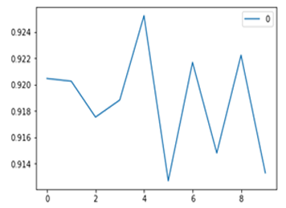
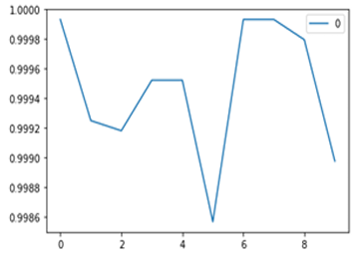
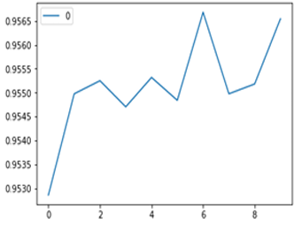
(x axis: folds, ; y axis: Accuracy)
Cross validation
Naive Bayes
Logistic Regression
Random Forest Classifier
Used 10-Fold Cross Validation. (x axis: folds, ; y axis: Accuracy)
Results:
Accuracy remained consistent across all folds.
Random Forest achieved the highest accuracy (~99.9%).
Model showed low variance and low bias due to better feature selection.
13

Slide 14

Conclusion and Future Directions
ML predicts software bugs early, improving development quality.
Random Forest delivers high accuracy; future: ANN and forecasting.
Applicable across all SDLC frameworks and reduces costs and enhances software reliability
Current Achievement
99.9% accuracy with Random Forest and K-fold validation
Future Enhancement
Artificial Neural Networks and bug quantity forecasting
Practical Impact
Universal model applicable across all SDLC methodologies
14

Slide 15

THANK YOU!
REFERENCES
[1] S. D. Immaculate and M. F. Begam, “Software Bug Prediction Using Supervised Machine Learning Algorithms,” IEEE Conference on Computational Intelligence, 2019.
[2] S. R. Chidamber and C. F. Kemerer, “A Metrics Suite for Object-Oriented Design,” IEEE Transactions on Software Engineering, vol. 20, no. 6, pp. 476–493, 1994.
[3] L. Kumar and A. Sureka, “Aging-Related Bug Prediction Using Extreme Learning Machines,” in Proc. 14th IEEE India Council Int. Conf. (INDICON), 2017, pp. 1–6.
[4] A. Nigam, P. Srivastava, and S. Misra, “Classifying Bugs Using Multi-Class Semi-Supervised Support Vector Machine,” in Proc. Int. Conf. on Pattern Recognition, Informatics and Medical Engineering (PRIME), 2012, pp. 393–397.
15

